Slide 1
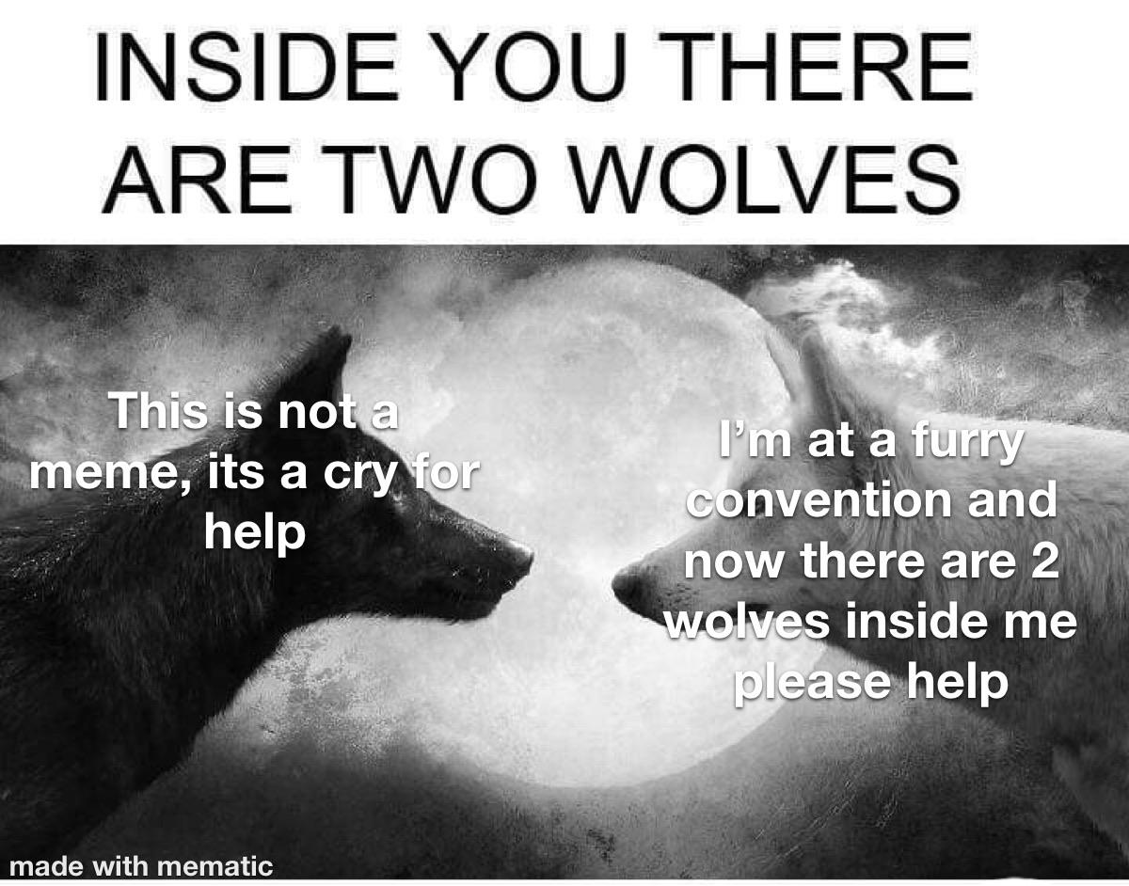

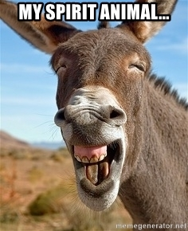
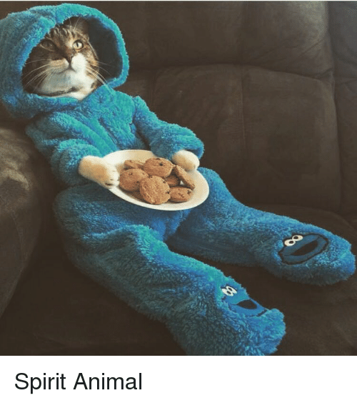
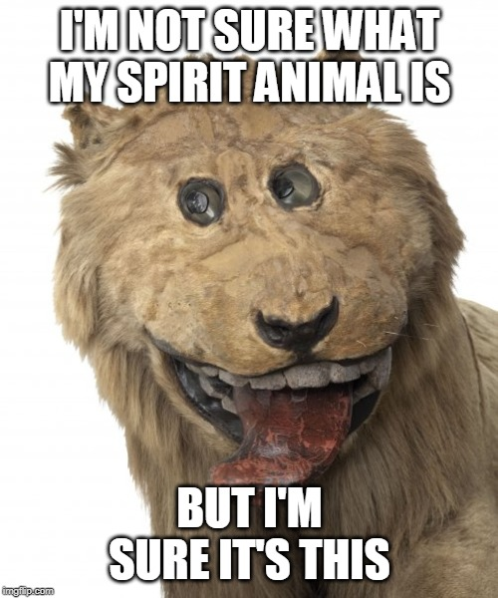
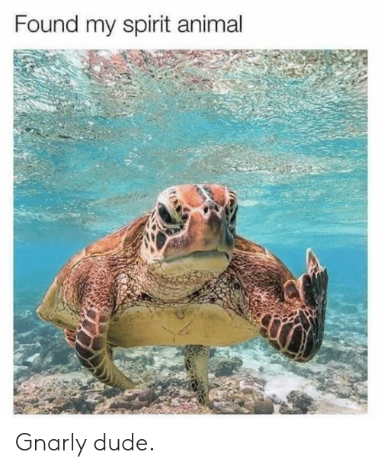

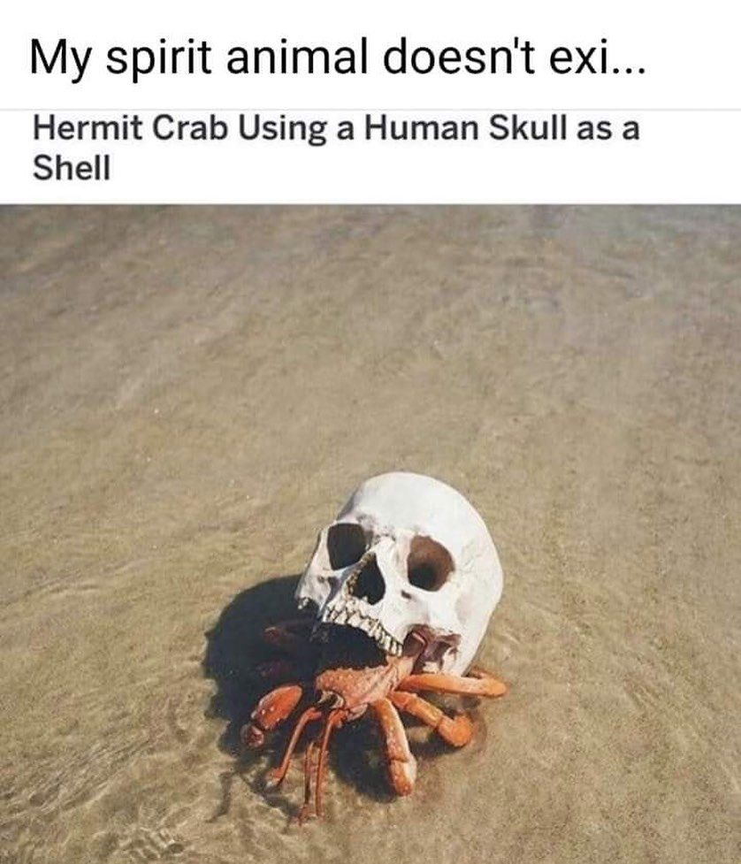
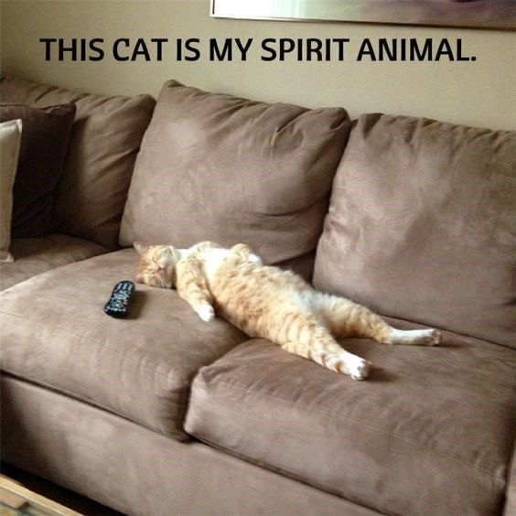
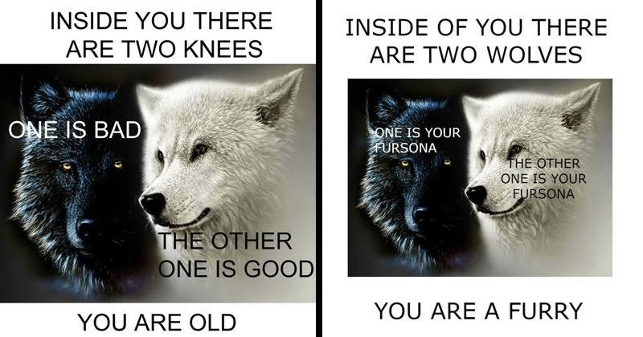
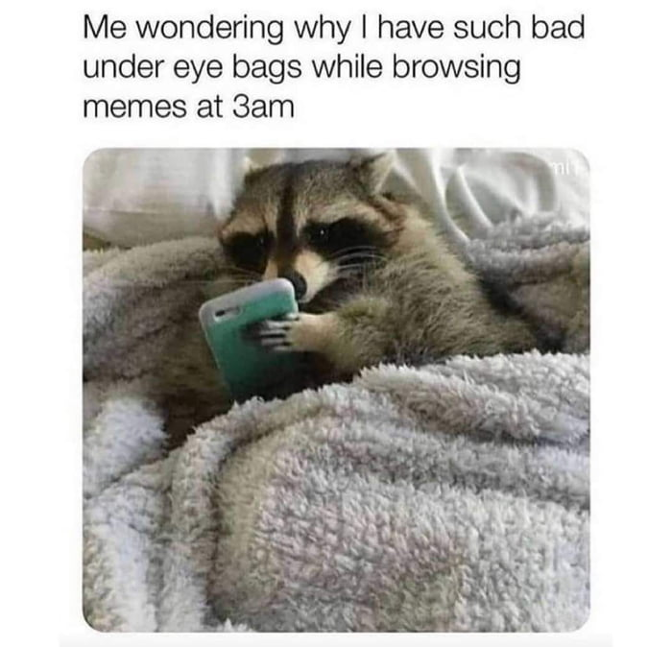
Your spirit animal & how you’d die
By: Me (duhh)

Slide 2
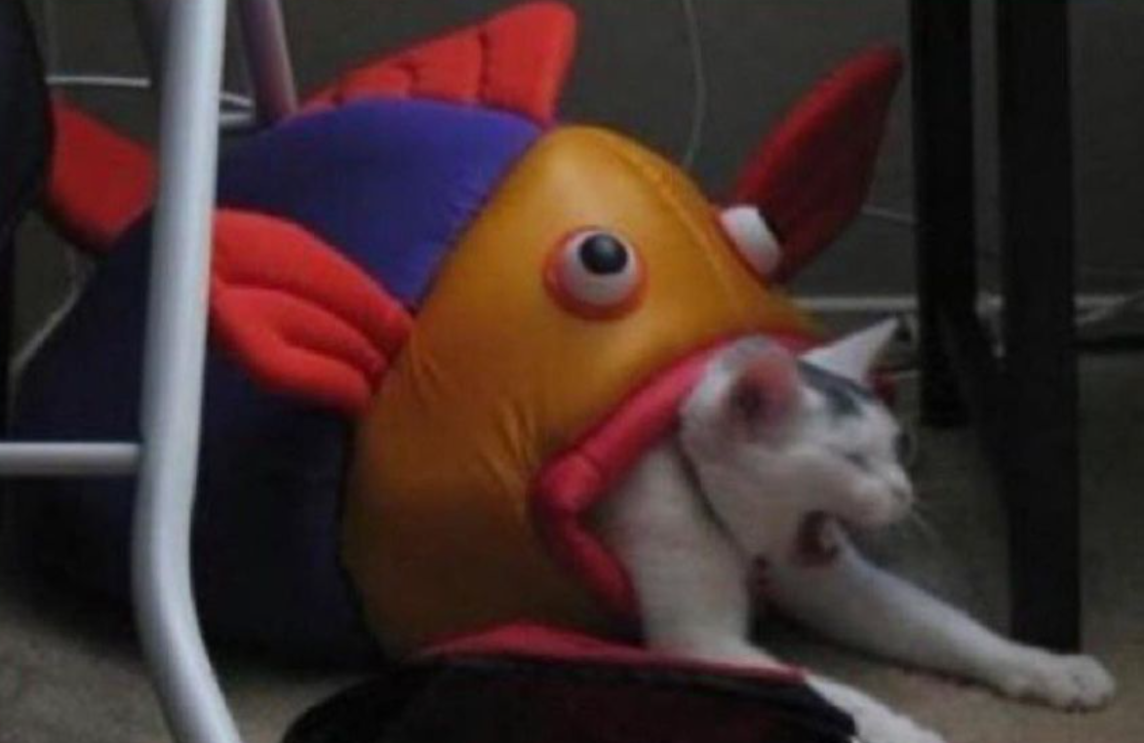
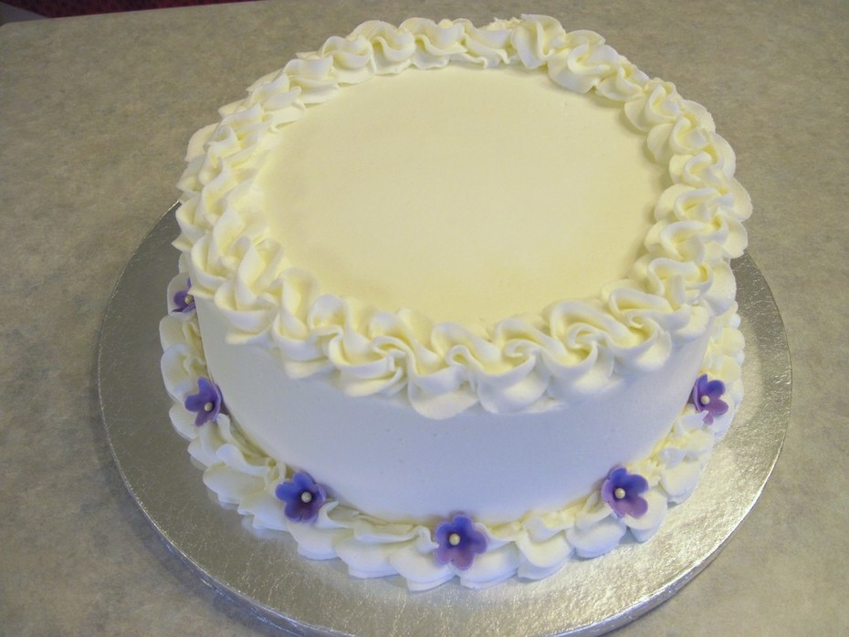
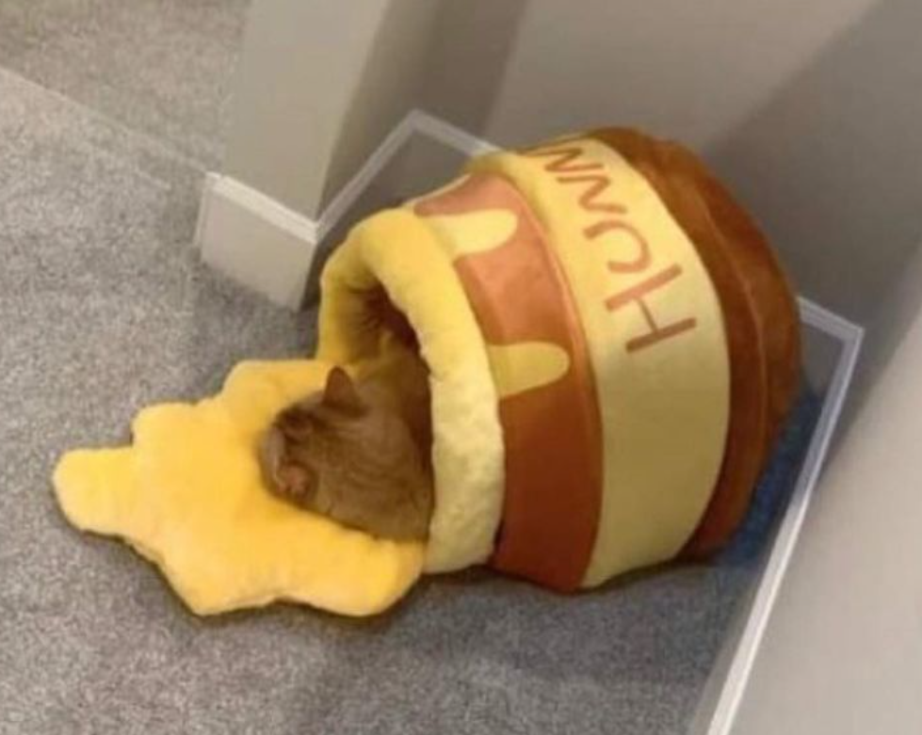
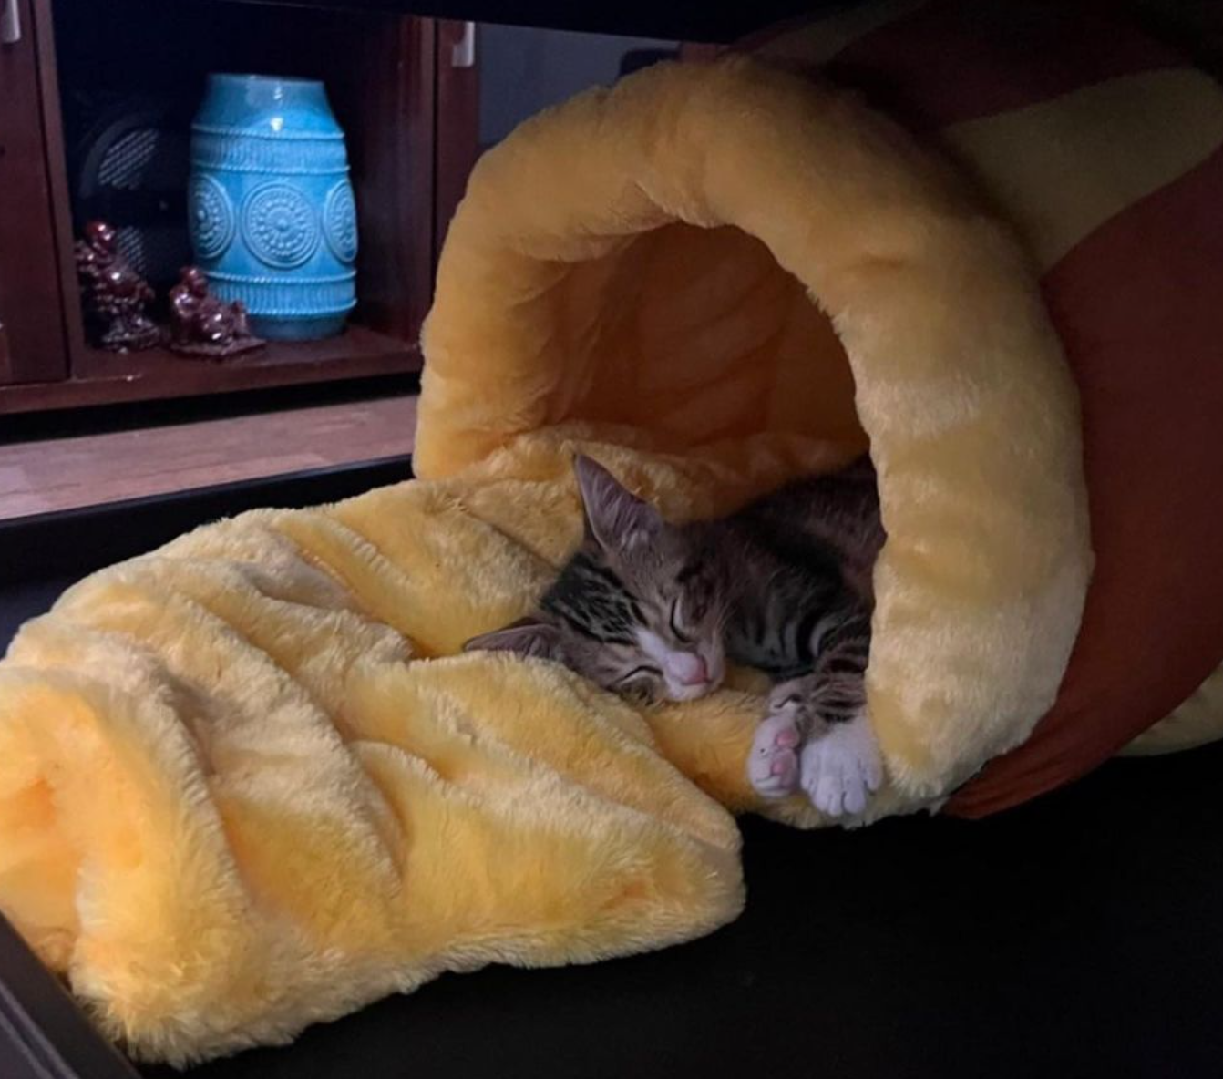
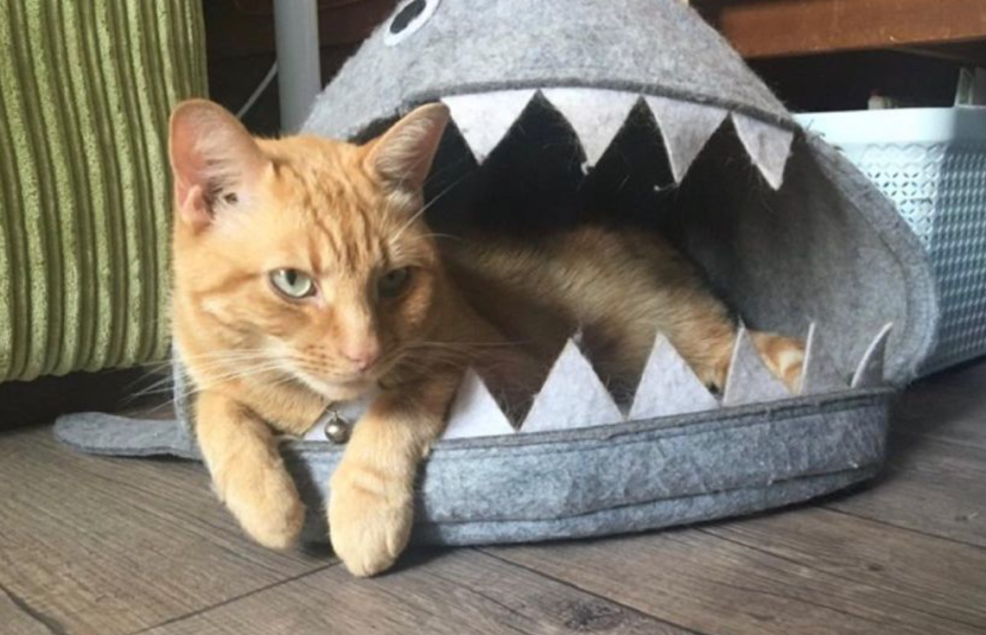
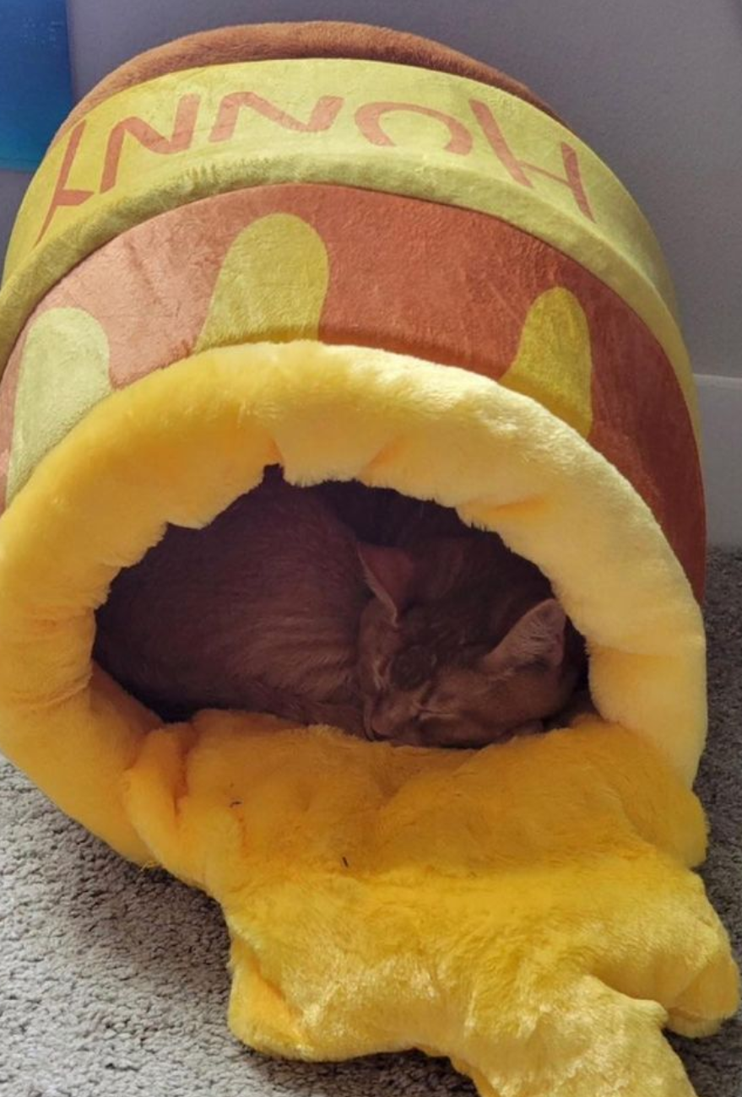
Disclaimer for Gabes gf
My PP
Me after finding out gabes gf was gonna be here
Please forgive me normally I’m more palatable with people I don’t know well yet
Looking away and not seeing this degenerate PowerPoint is an option
As an apology here are some cute animal pictures
I hope you feel very welcome here it’s nice of you to come ☺
Once again I’m so sorry
Sorry

Slide 3

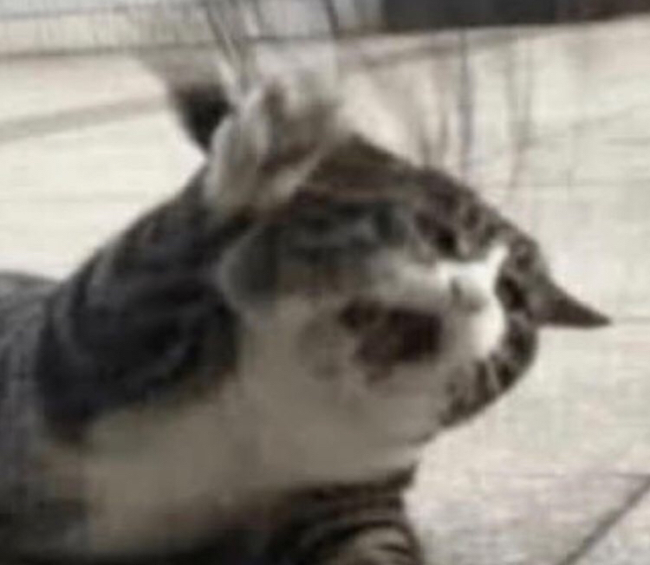
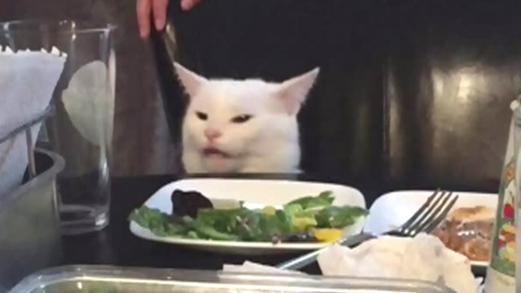
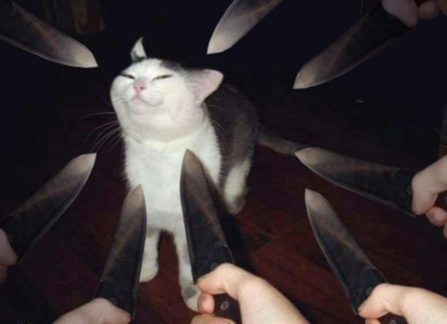
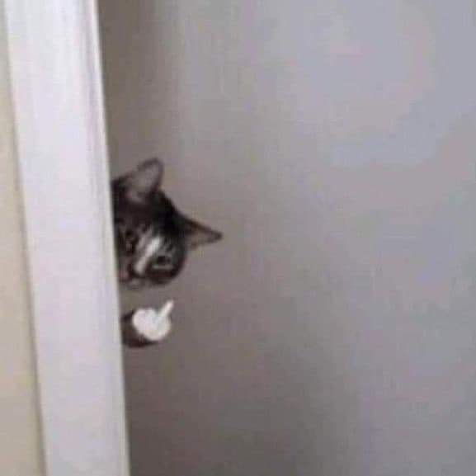
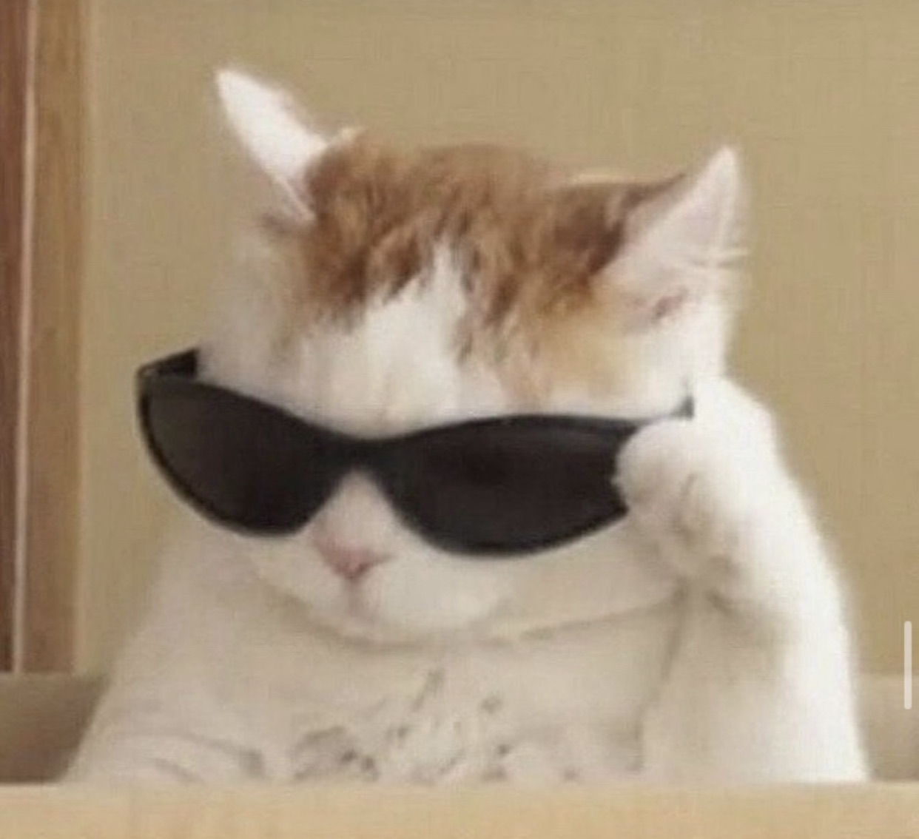

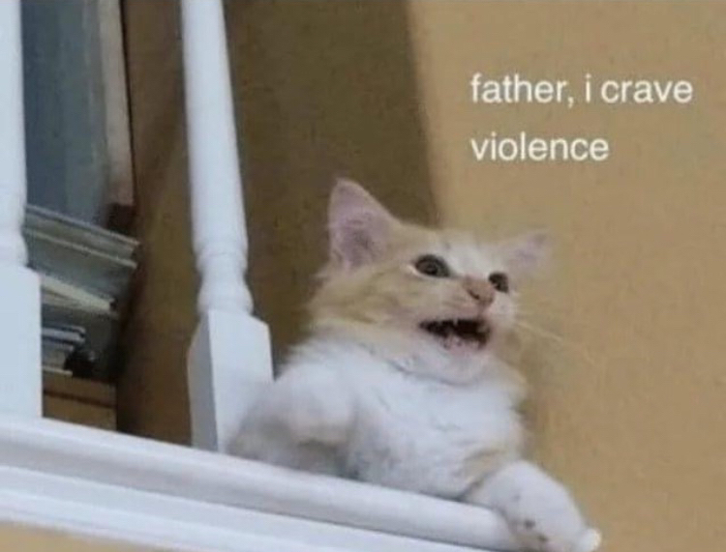
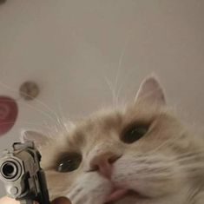
Amber: Cat
Good on her own
Will pick a fight with you
Will warm up to you eventually
Cute
Bad memory
How she dies:
Sassed off to the wrong person

Slide 4
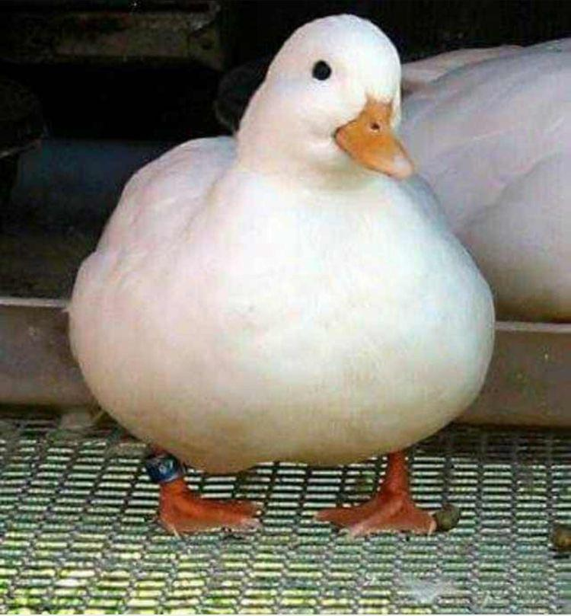
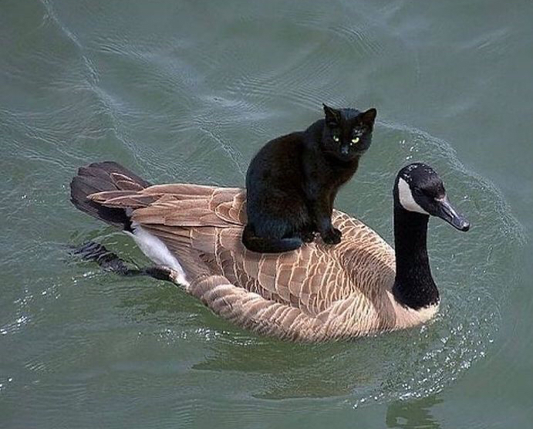
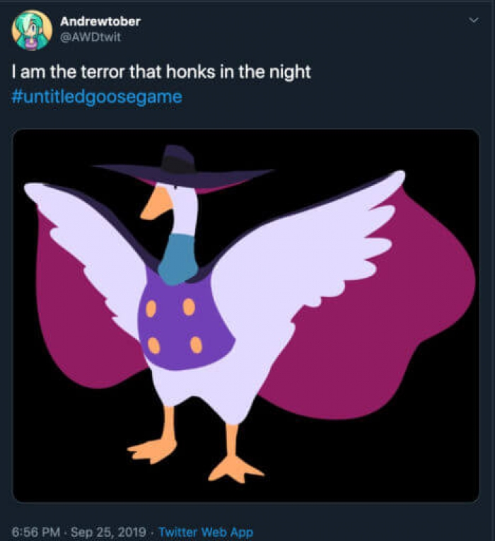
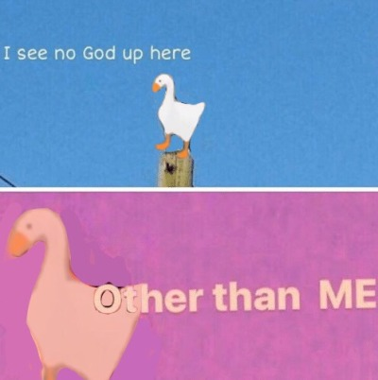
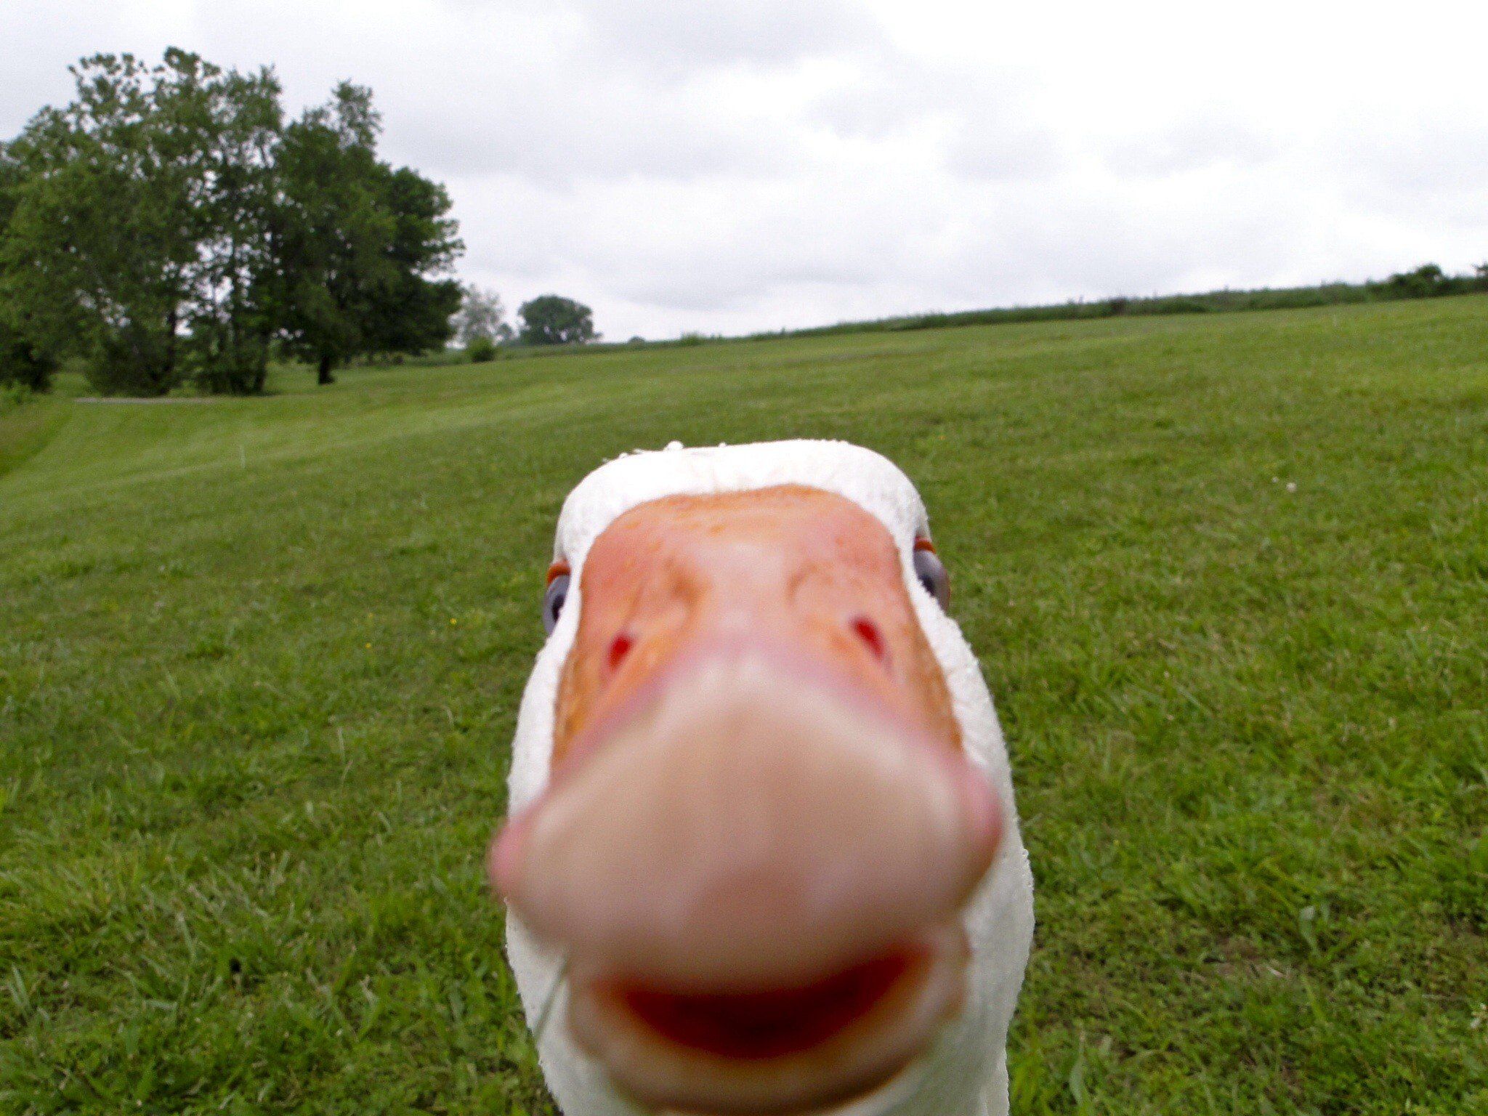
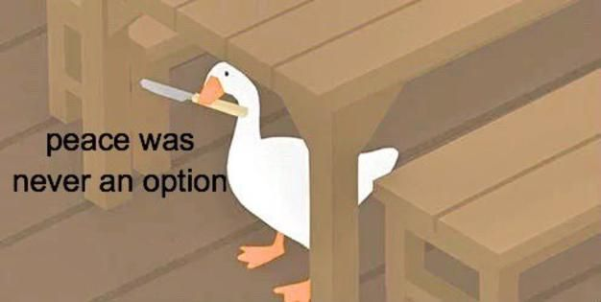
Liam: Goose
Pride
Aloof
Based
Will go clubbing with his skein of fellow geese
Think twice before attacking
How he dies:
Said “I will forgive you” unprompted one too many times

Slide 5
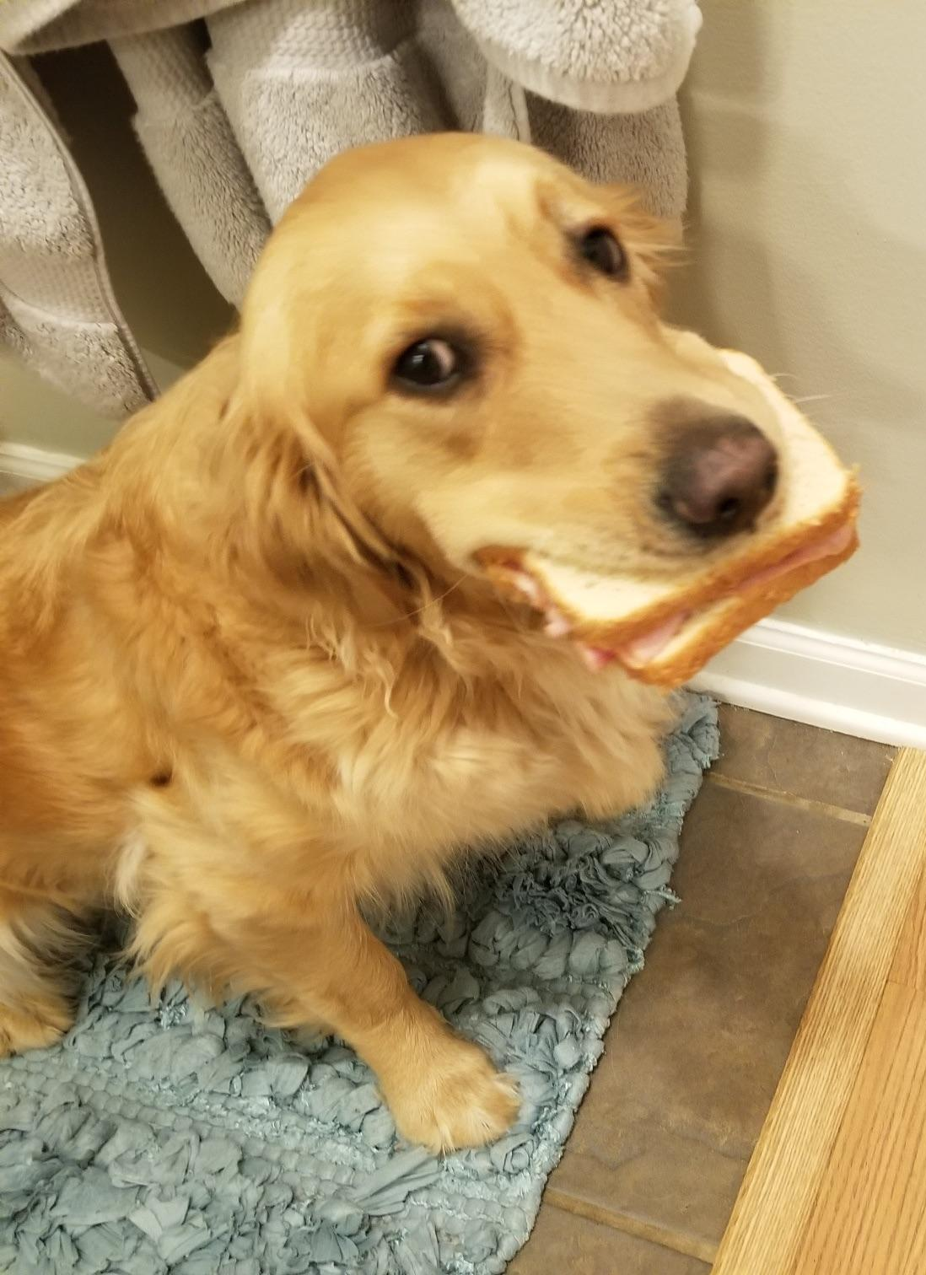
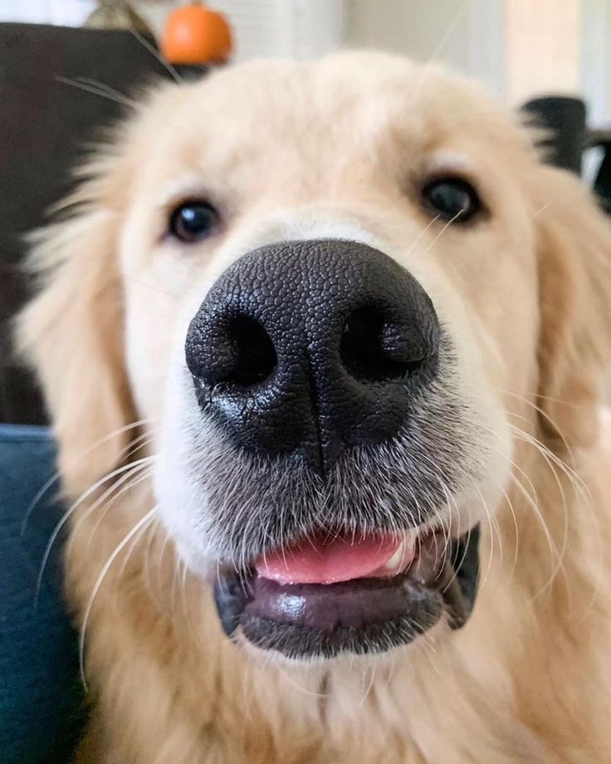
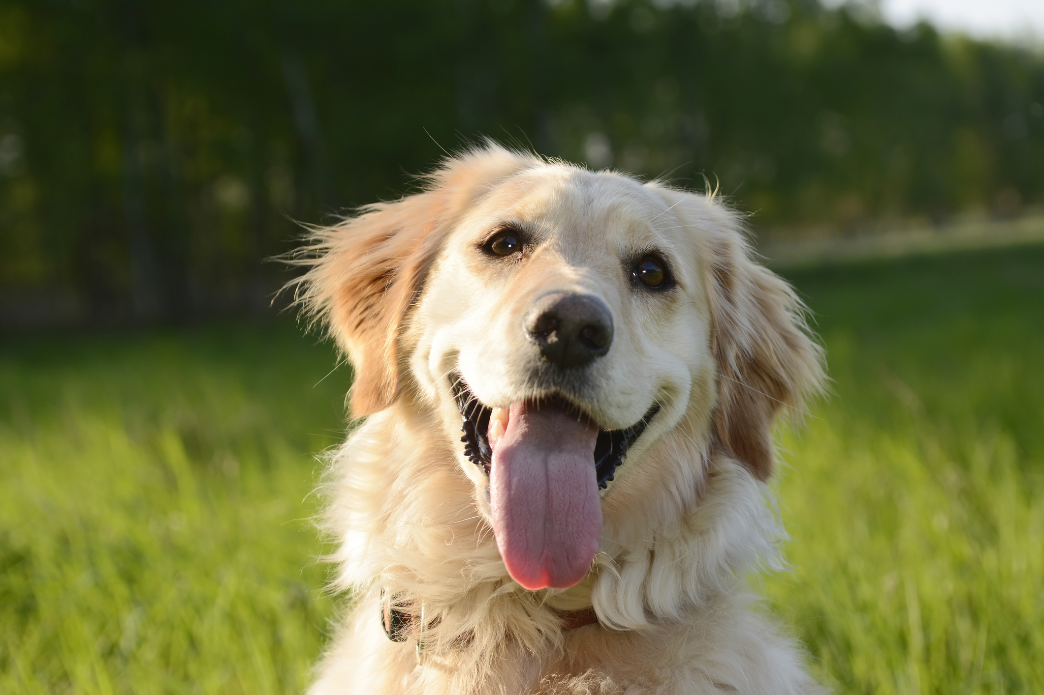
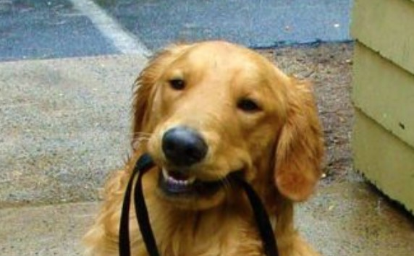
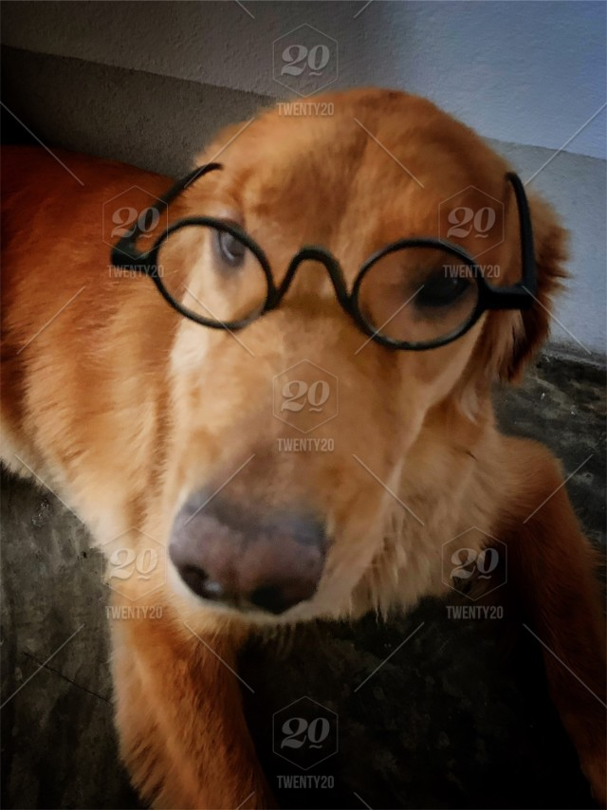
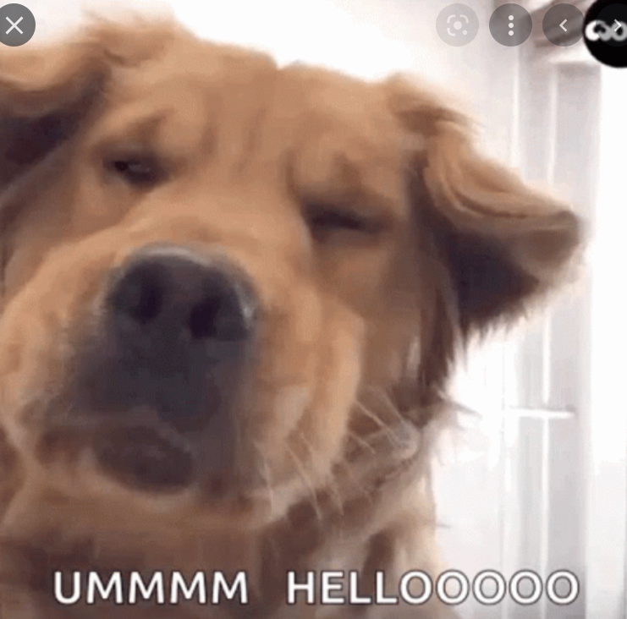
Mark: Dumb golden retriever
Overly friendly to strangers new people
Doesn’t get the hint
No danger sense
Doesn’t mind getting insulted
Overconfident
(blond hair)
How he dies:
Insulted a stranger during a night walk. (he does this quite often see point 3)

Slide 6
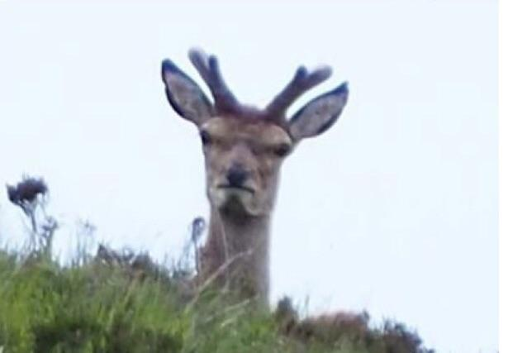
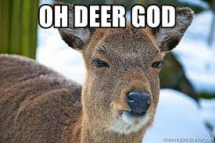
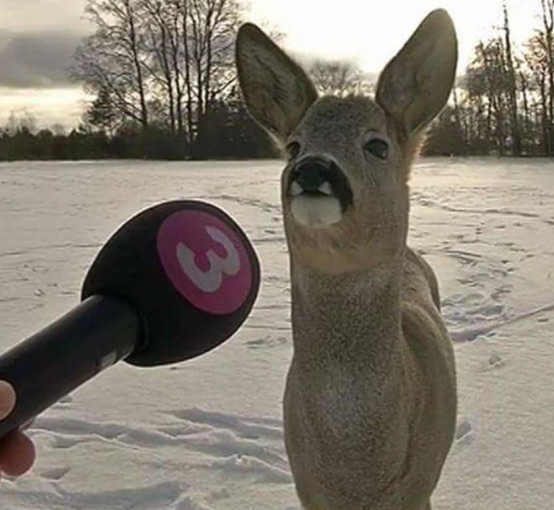
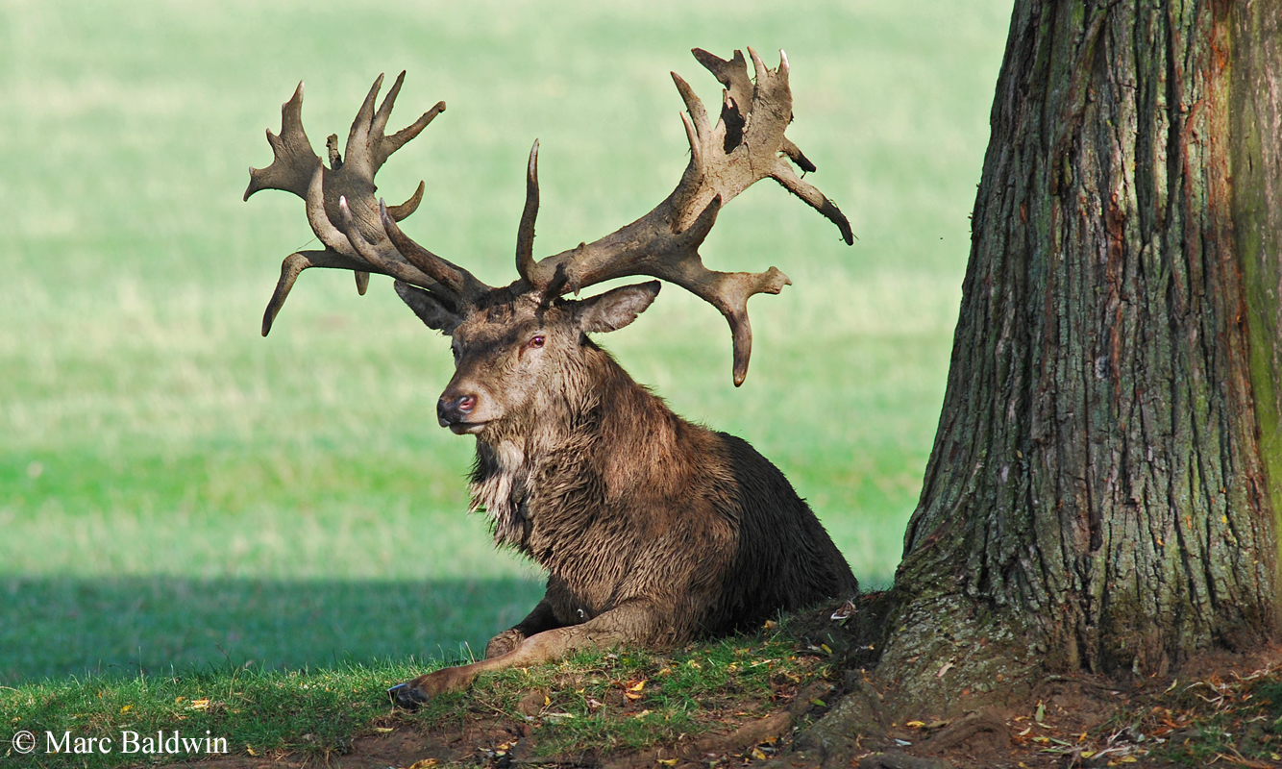
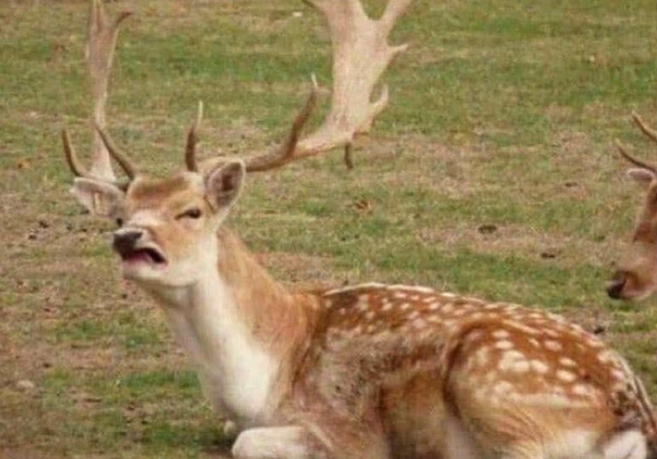
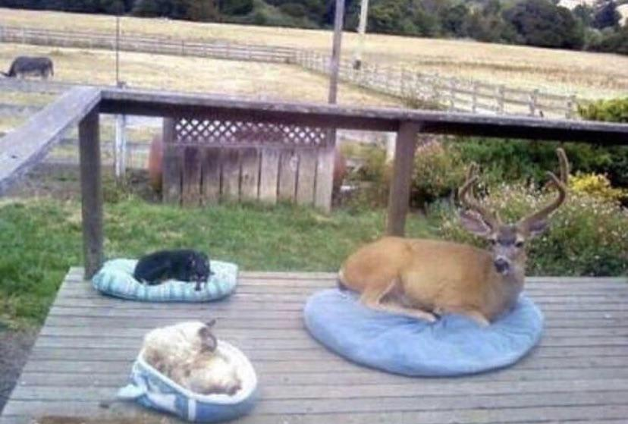
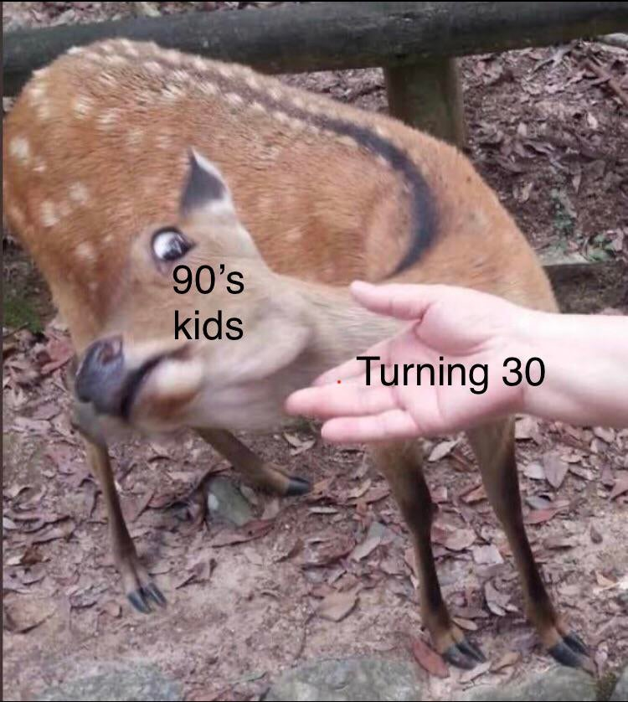
Farris: Deer
Is a dear
Reliable
Old
Kind
Hates math (fun fact: most animals don’t like math)
How he dies:
Old age
Farris after a math lesson
Farris after the DM asks for a recap
Farris after horny memes

Slide 7
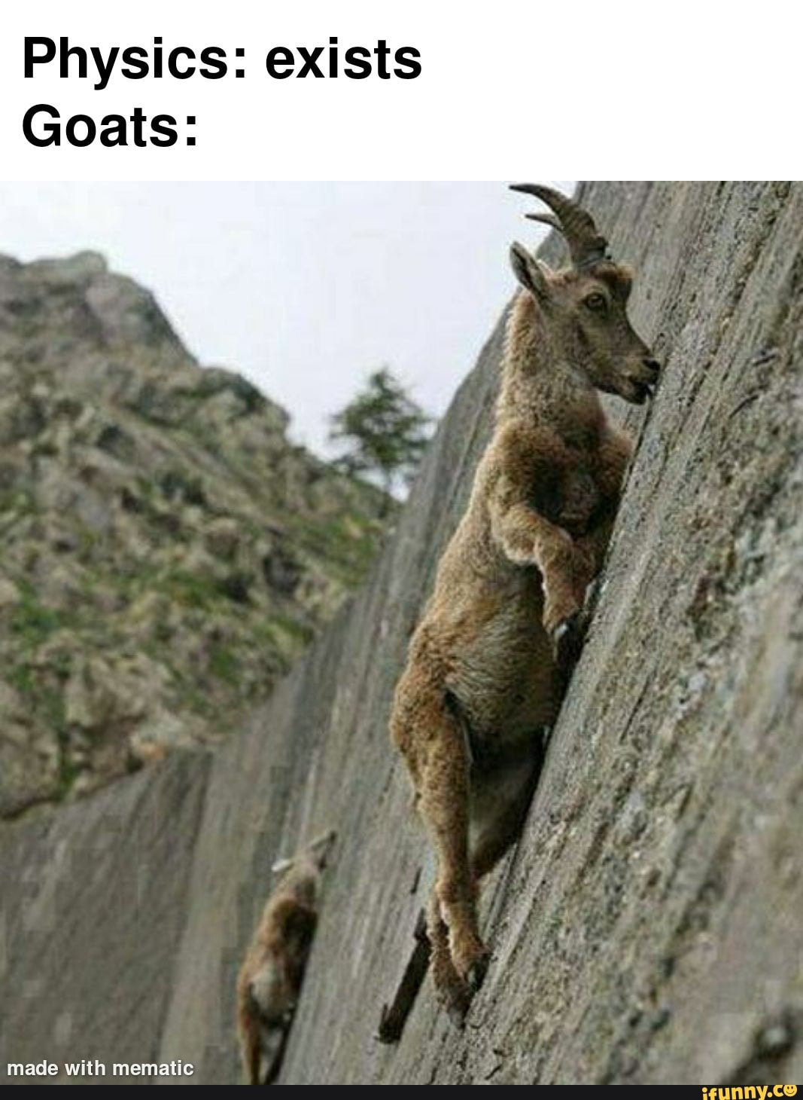
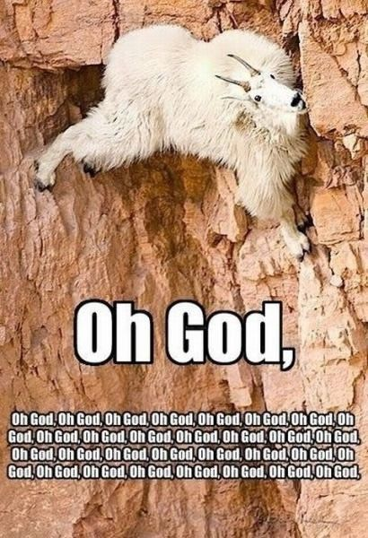
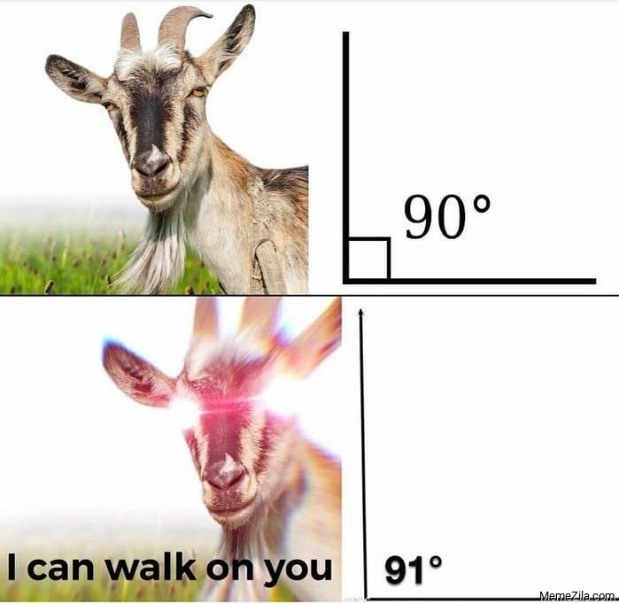
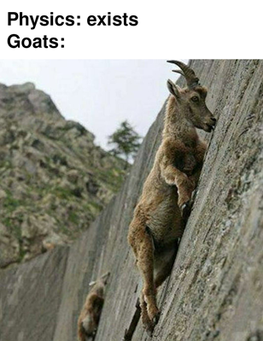
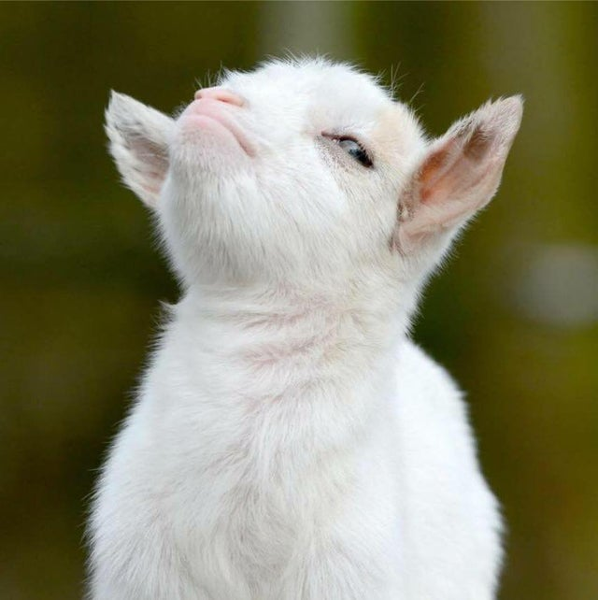
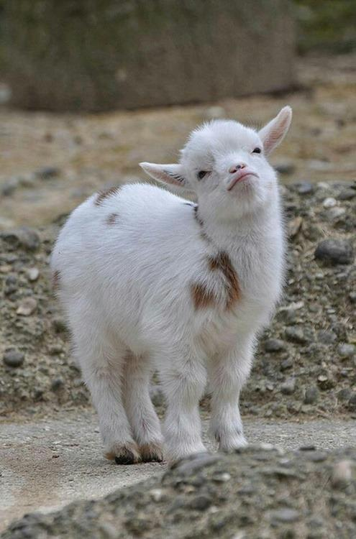
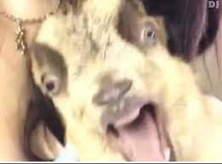
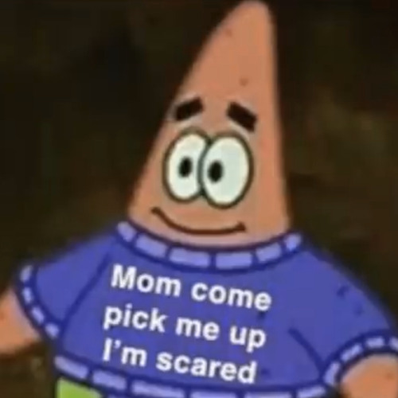
Gabe: Young mountain goat
LOVES to live on the edge
Chaotic
Problematic
Doesn’t know about sex
??? How did he even get in this situation?? How will he get out???
How he dies:
Didn’t understand what his gf meant by extreme pegging

Slide 8
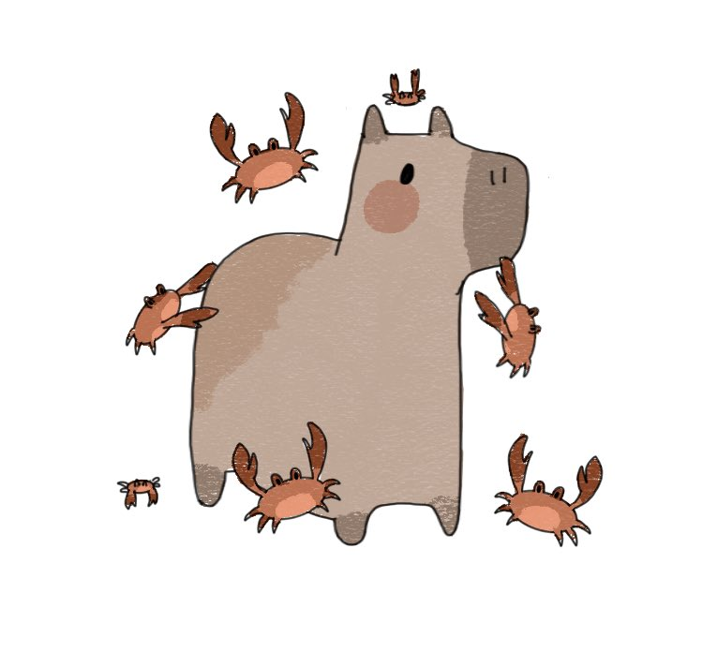






Jarex: Capybara (with lots of crab friends)
Vibes with everyone
Wholesome
Chill
Interesting no matter what he talks about
Blessed boi
How he dies:
Tricked the wrong person into a deez nuts joke

Slide 9





Poke: Scalie
Horny
A scalie
Likes commissions
Used to being bullied by everyone else
SIMP
How he dies:
Dommy mommy went too far (he died willingly)
Literally provided me with evidence yesterday (unprompted)

Slide 10





Lupus: Fox
Wise beyond belief
Creative
Playful
Wholesome
Great (red) hair
How they die:
Questioned god.

Slide 11









Barth: Magpie
Can (sword) fight
Oh shiny rocks!
Knows shit
Meme boi
The LAW
How he dies:
Lost a sword fight

Slide 12









Leon: Raccoon
Dark circles under his eyes
Stays up all night
Trash
Can be vicious
WILL attack you if you attempt to pet
How he dies:
Exhaustion

Slide 13










That’s it
Questions?

Slide 14










BOOONUS CONTENT!
Ranking: Most daddy to least daddy

Slide 15
Ranking: Most daddy to least daddy
Amber (owns the server, is a boss)
Jarex (dad jokes, good at barbecuing)
Farris (old, actual dom)
Barth (big brain, will call you out on your bullshit)
Liam (based, (still) goes to parties tho)
Lupus (dreamer, amazing hair)
Gabe (too young, too unbothered by the realities of this world)
Mark (You’ve seen him dm I would not trust him with children)
Poke (literally so sub I couldn’t put him on any other place)

Slide 16
THE END (real one)
Work cited: My big brain

